Slide 1

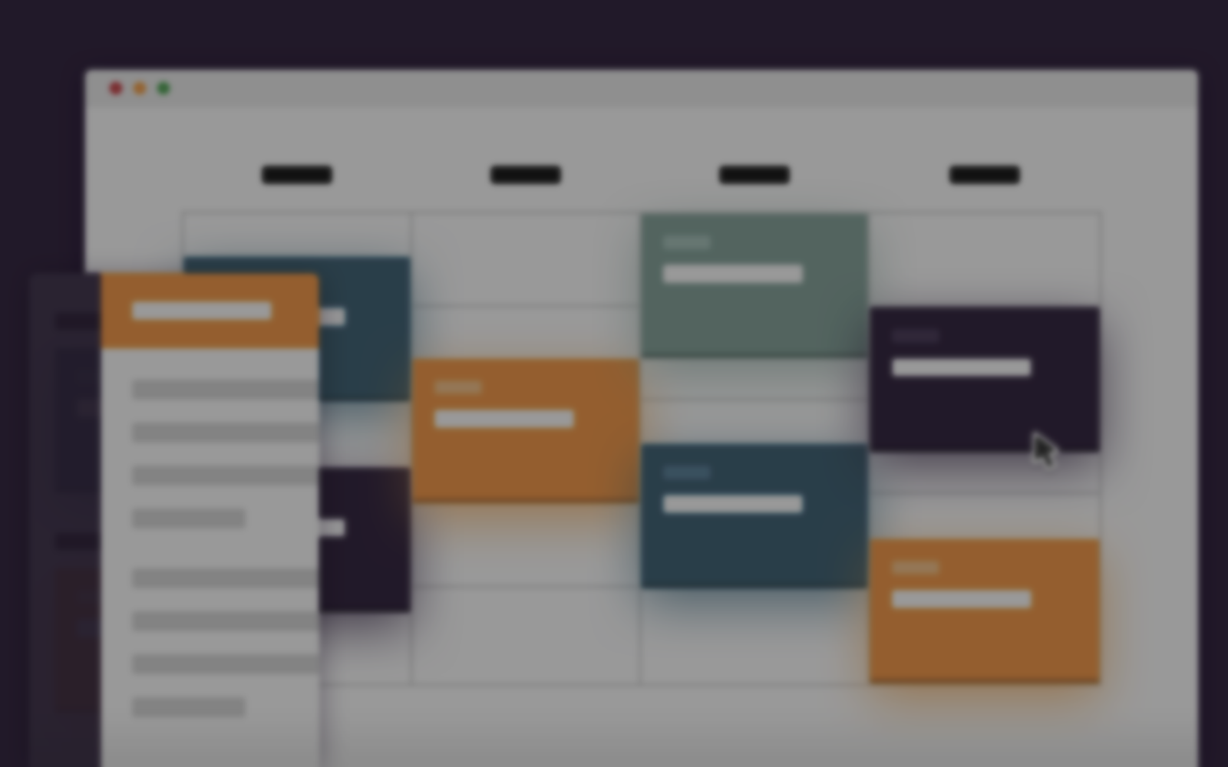
Course Outline

Slide 2
Rough schedule
Monday
Types
Multiple Dispatch
Tuesday
Linear algebra
Machine learning
Wednesday
Parallelism
Thursday
Friday
- Holiday -
Hackathon
Gotchas
Environments
Profiling
Debugging
Ecosystem
Generic programming
Workflow
Revise
Git + GitHub
MyPackage 1.0
Julia Community

Slide 3
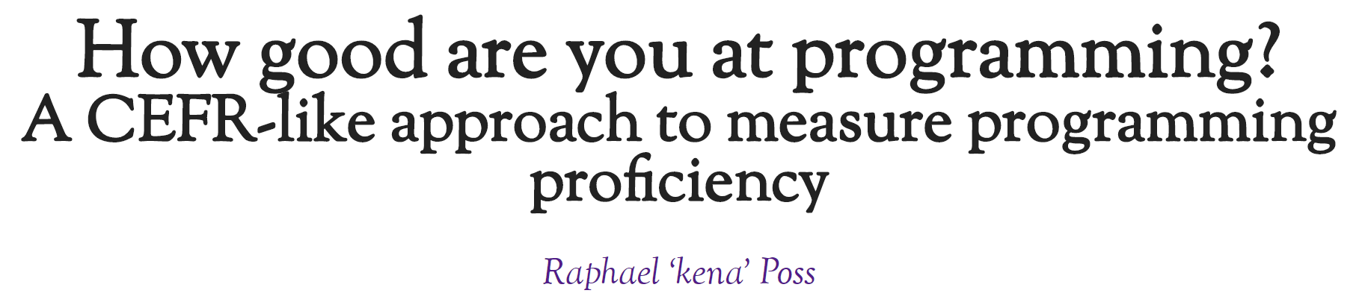
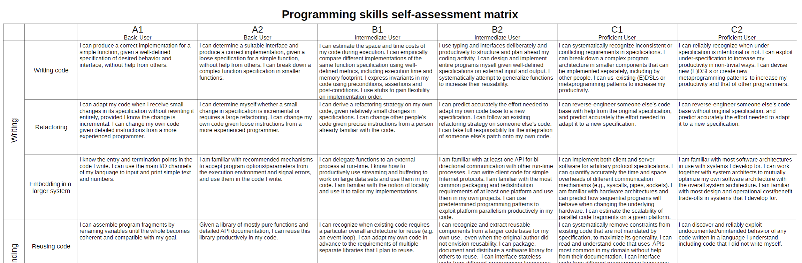
https://science.raphael.poss.name/programming-levels.html
Notes:
Common European Framework of Reference for Languages – language proficiency

Slide 4
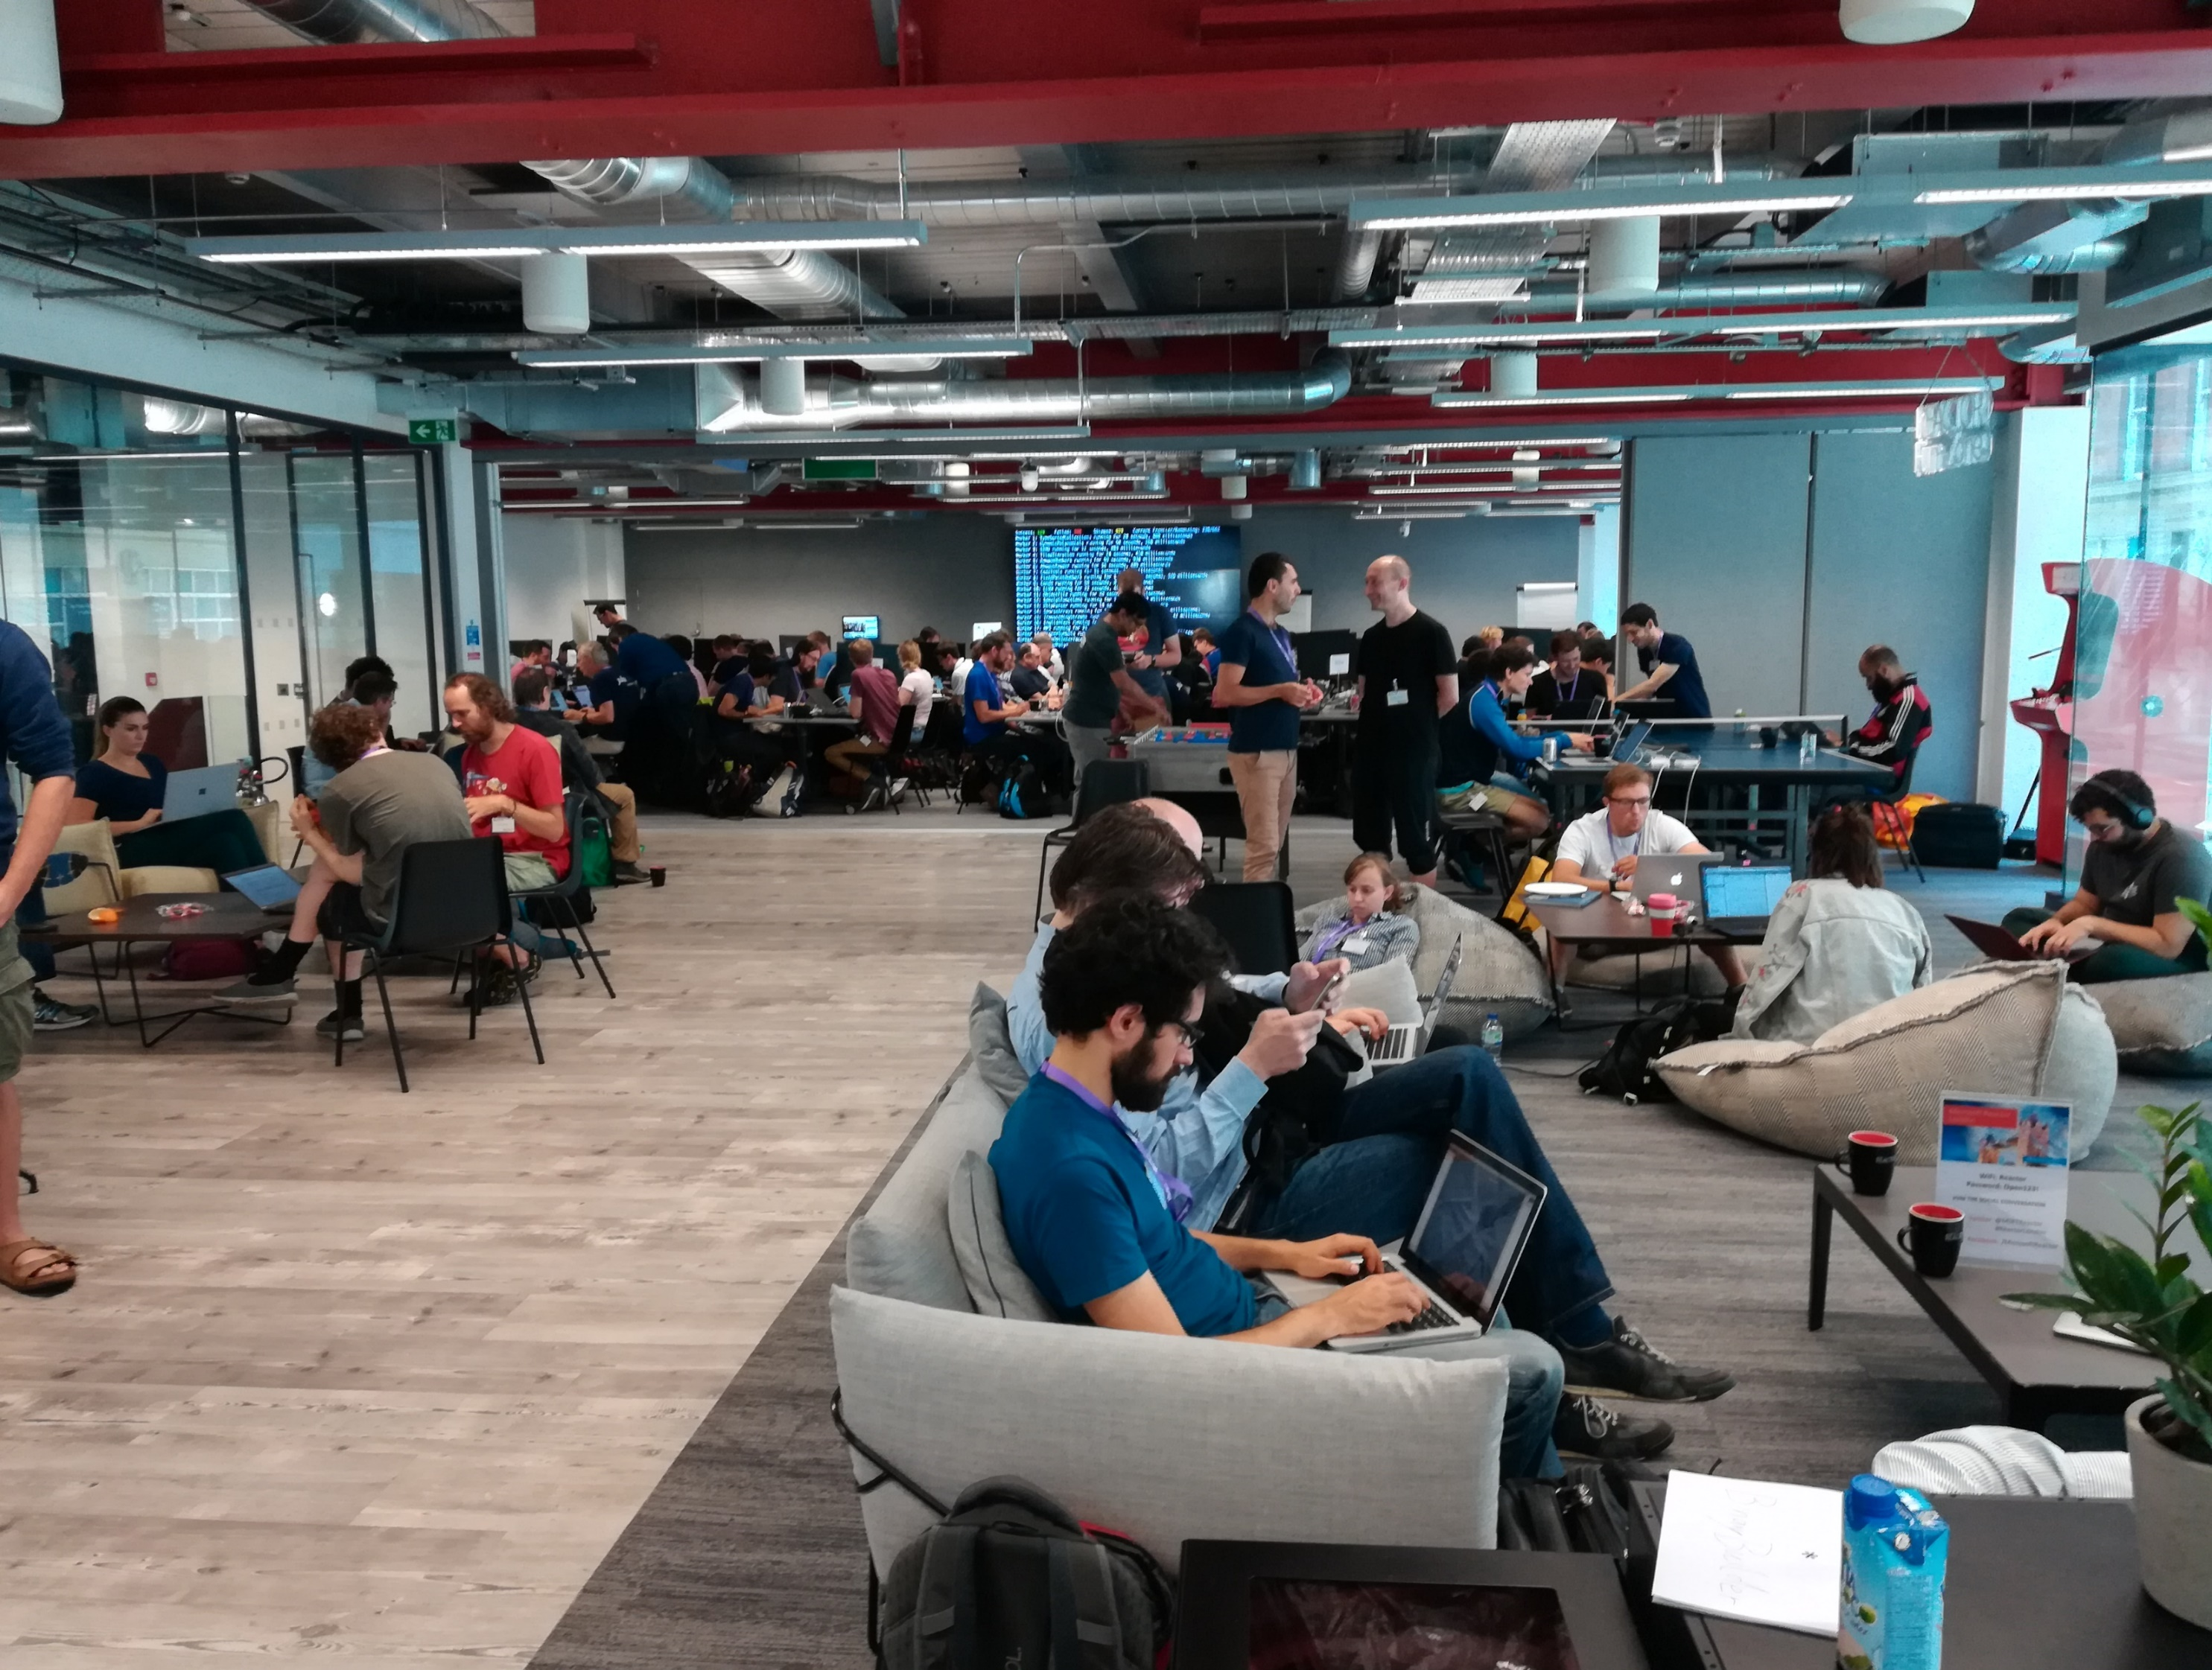




2018

Slide 5
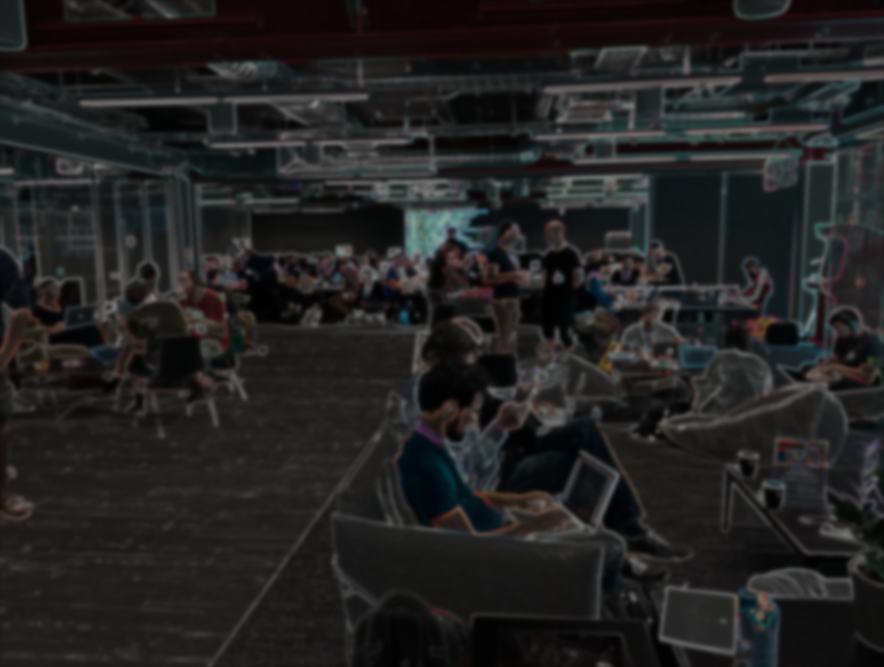

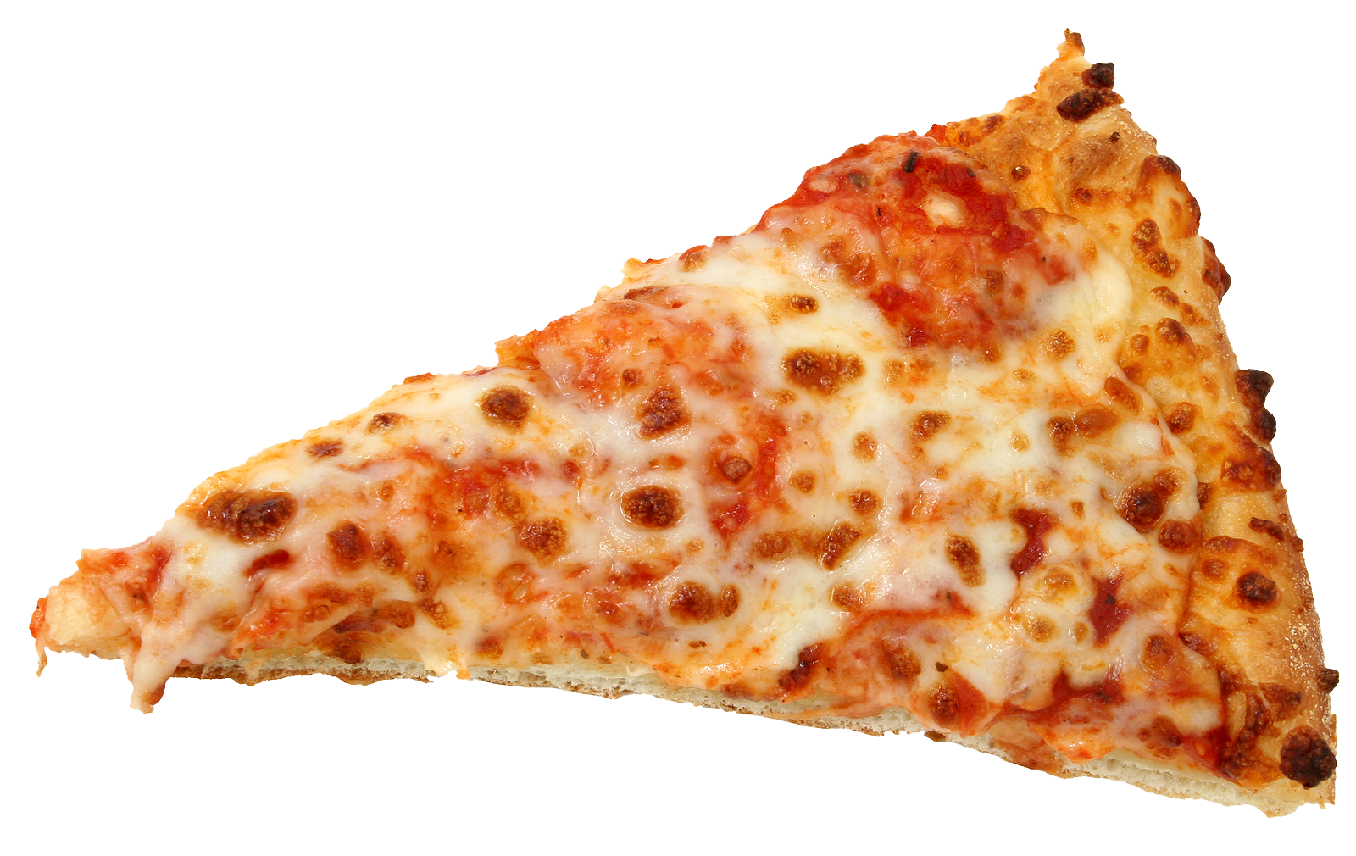
Hackathon
Choose a problem
Connect with others
Solve together!
Eat free pizza ☺

Slide 6
Hackathon
Choose a problem
Connect with others
Solve together!
Eat free pizza ☺

Slide 7


Hackathon
Choose a problem
Connect with others
Solve together!
Coding together is fun!

Slide 8

Disclaimer
This workshop will be opinionated!
This workshop will be incomplete!
The topics will (likely) be too easy and too difficult!
There are other great languages out there!

Slide 9
Workshop materials
Terminal
git clone https://github.com/crstnbr/julia-workshop-2019
cd julia-workshop-2019
julia install_dependencies.jl

Slide 10
Workshop materials
Julia REPL
using Pkg
Pkg.GitTools.clone("http://tiny.cc/julia", "workshop")
cd("workshop")
include("install_dependencies.jl") # might take a while

Slide 11
Workshop materials
Browser
Download https://github.com/crstnbr/julia-workshop-2019/archive/master.zip
Unzip the file.
Open the Jupyter notebook install_dependencies.ipynb and execute the cells.

Slide 12
Workshop material
Browser:
https://github.com/crstnbr/julia-workshop-2019/archive/master.zip
Terminal:
git clone https://github.com/crstnbr/julia-workshop-2019
Julia:
using Pkg; Pkg.GitTools.clone("https://github.com/crstnbr/julia-workshop-2019", “workshop")

Slide 13
Install dependencies
Browser:
Execute cells in the jupyter notebook install_dependencies.ipynb
Terminal:
julia install_dependencies.jl
Julia:
cd("workshop"); include("install_dependencies.jl")

